Slide 1
Real-time Analytical Monitoring Application
ISS – SERIS – RAM Application
Project Presentation / Iteration 2
Project Guide – Heng Boon Kui
SE-25 Part-time / Team 07
Balasubramanian Narasimhan
Kaung Myat Bo
Gao Zhiyu
Nay Lin Aung

Slide 2

Team Members (6...5...4)
SE 25 Part-Time / Team 07
Project Guide – Heng Boon Kui
Balaubramanian Narasimhan (Bala)
Kaung Myat Bo (KM)
Gao Zhiyu (William)
Nay Lin Aung (Nay)
Treza Bawm Win (Withdrawn)
Vincent Agnes Evangelin (Withdrawn)

Slide 3

Agenda
Brief overview & Recap
Use Case Model (global View)
Incr-2 dev strategy & Software Architecture
Transition Strategy (with one Use Case)
Technical Issues / Problems
Demo.
Testing Strategy
Project Progress, Risks & Challenges
Q & A

Slide 4

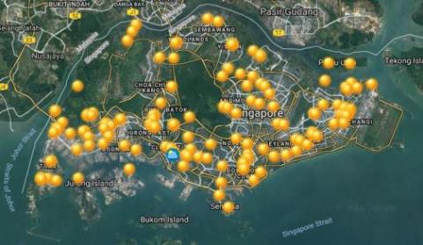
Project Sponsor
Singapore’s national institute for applied solar energy research
Is dedicated to research, development, testing and consulting on solar energy technologies and their integration into power systems and buildings
is globally active but focuses on technologies and services for tropical regions, in particular for Singapore and South-East Asia
is jointly sponsored by Singapore’s National Research Foundation (NRF) - via the Singapore EDB, and NUS
Campus located at NUS
National Solar Repo. of SG

Slide 5

Project Objectives
Real-time Analytical Monitoring Application
To develop a cloud based platform for integrating and managing real-time analytical monitoring of PV systems performance
Cloud Platform: An integrated cloud platform to support and meet the application's requirements
Web portal: A web portal for users to access the application components
Data Engineering & Visualization: A cloud based application that can record, transform and report the data sent from PV systems

Slide 6

Requirements Overview
A Web portal – A web portal for users to access the application components
User Management
Device & Station configurations
Report configuration
Central Data Engineering – A cloud based application that can record, transform and report the data sent from PV systems.
Data Capture – Cloud based components that captures and records the incoming data sent from sensors
Data Visualization – Cloud based visualization component that performs back-end calculations and make it available for front-end visualization

Slide 7
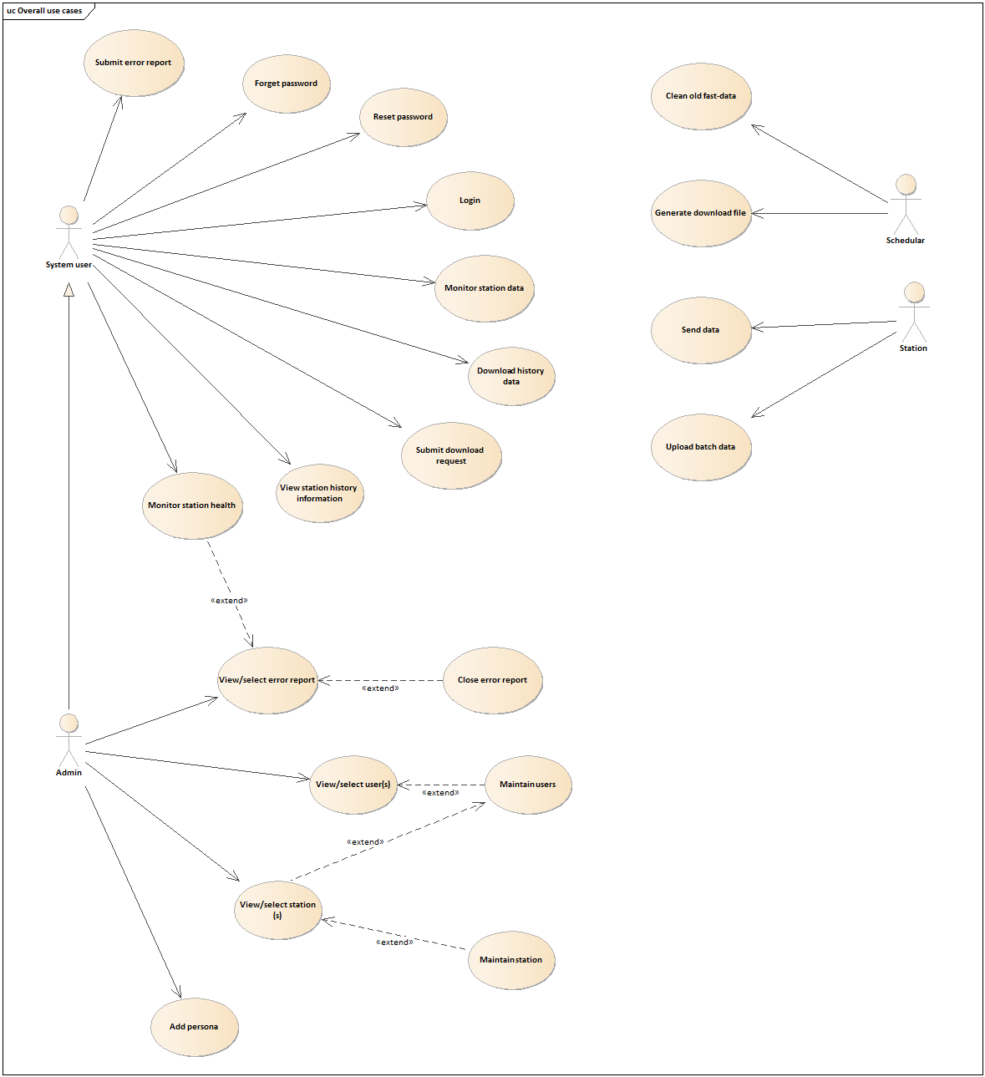
Use Case Model

Slide 8
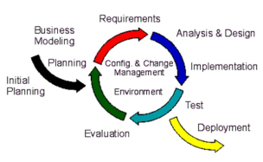
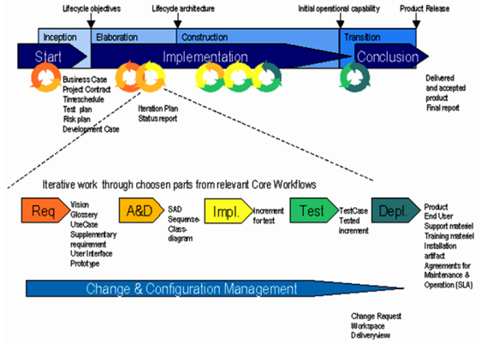
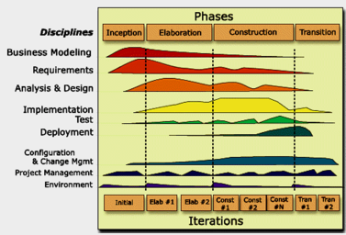
Project Methodology – RUP and Iterative Dev.
RUP – Rational Unified Process
A well defined SE Process; Static dim(organized into workflows, activities, process disciplines, artefacts and roles) & Dynamic dim(Time)
RUP and Iterative Development
Planning & Feasibility
Increment 1 & 2

Slide 9
Deliverables and Increments
Planning & Feasibility Phase | Increment 1 Development Phase | Increment 2 Development Phase
Project Plan Quality Plan User Requirements Specification (URS) Use Case Model Survey (UCMS) Prototyping Study Report High-Level Design Spec | Requirements Model Report High-Level Design Spec(revised) Design Model Report System Test Documentation Acceptance Test Documentation Project Plan (revised) User Guide | Requirements Model Report (finalized) High-Level Design Spec(finalized) Design Model Report (finalized) System Test Doc (finalized) Acceptance Test Doc (finalized) User Guide (finalized) Final System End of Project Report

Slide 10

Prototype
Phase – I
Windows acting as a device (Simulation)
Sending data to IoT Core
Subscribe to MQTT topic
Extract and Display the transmitted msg
Configure rules in AWS IoT to Trigger lambda fn()
Invoke a lambda function
Message Persistence in dynamoDB
Stores these messages into dynamoDB
Phase – II
lambda sends message back to IoT core
IoT core captures the message sent by lambda

Slide 11
Project Effort Estimation
Use Case Point Estimation
Unadjusted Use Case Point (UUCP) | Total Weight (Actors + UseCases) 16 (actors) + 130 (use cases) 146
Use Case Point (UCP) | UUCP x TCF x EF 146 * 1.02 * 0.89 132.54
Effort (man days) | UCP x ISS_Productivity_Factor 132.54 * 17 2,253 man hours; i.e. 282 man days
TCF – Technical Complexity Factors →1.02 EF – Environmental Factors → 0.89

Slide 12
Project Status (Timeline)
2 - May
29-Aug
Phase / Timeline | Jan 2018 | Feb | Mar | Apr | May | Jun | Jul | Aug | Sep | Oct | Nov | Dec 2018 | Jan 2019
Increment 0 |  |  |  | 7
Increment 1
Increment 2
Initial Planning
Requirements Engineering
Requirements Analysis
Analysis and Design
Dev. (Env. Setup & Coding)
UT
SIT
SAD
Development
SIT
*UAT
#
@
*Training – Train the trainer # – Training @ – Handover
12

Slide 13
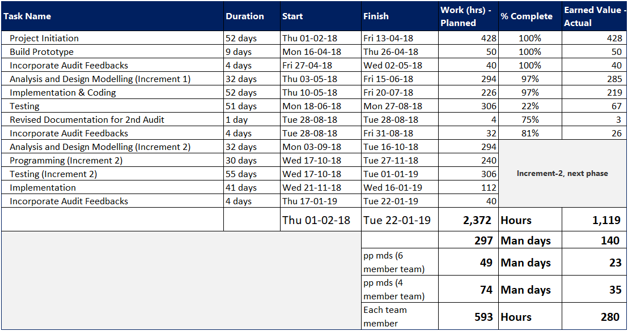
Project Effort

Slide 14
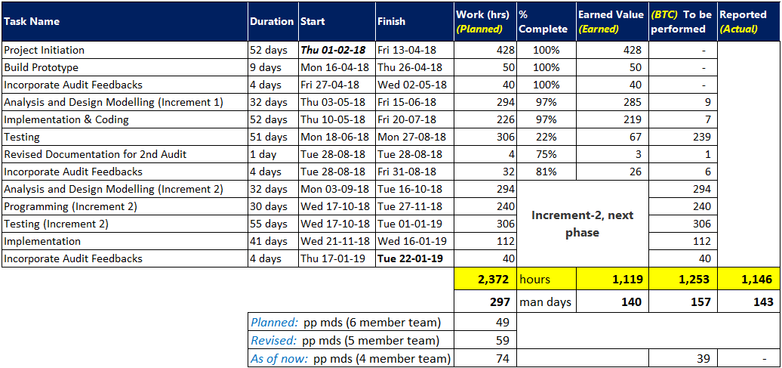

Project Status (Control, Tracking and Reporting)

Slide 15
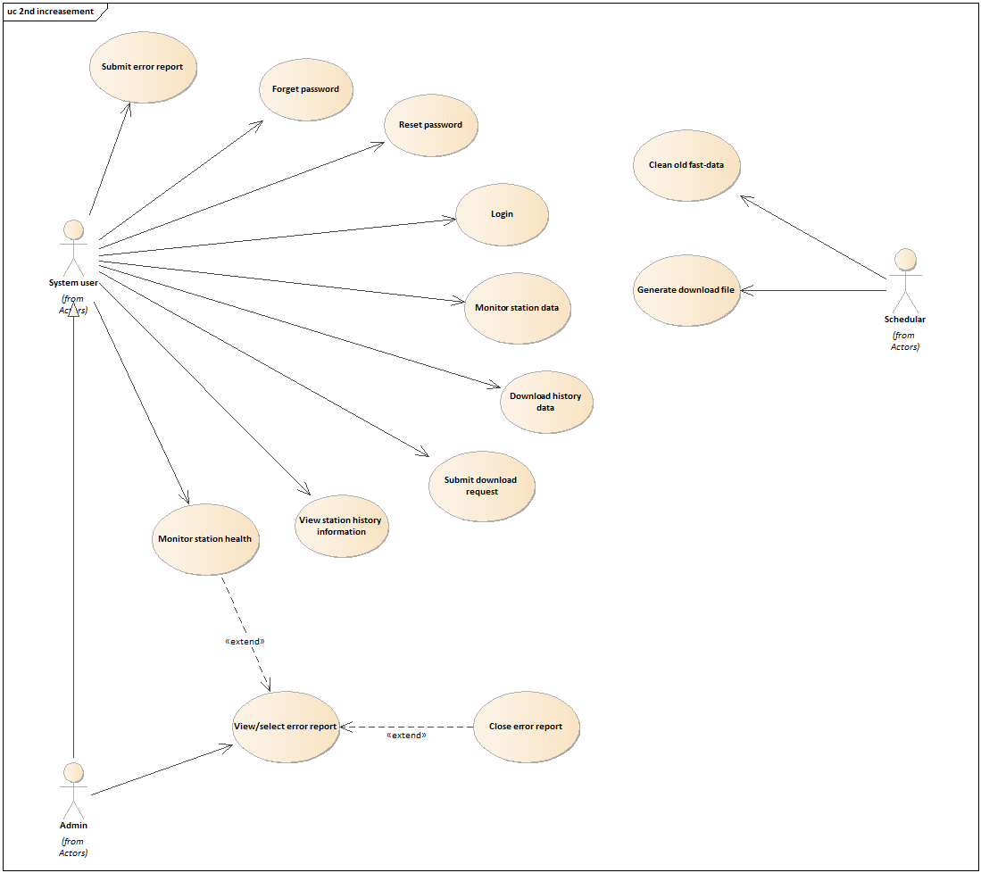
Use Case Model
(Increment-2)

Slide 16
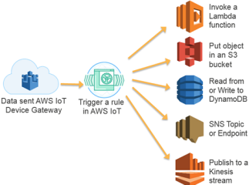
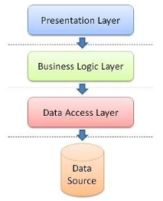
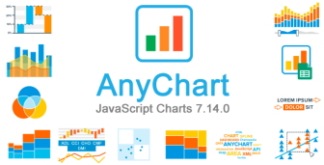
Architecture & Technologies Used
AWS IoT Landscape
AWS IoT Core
AWS Lambda
AWS S3
Elasticsearch Service
MySQL DB
Backend Web-Service API
Front-end web application
Chart Libraries

Slide 17
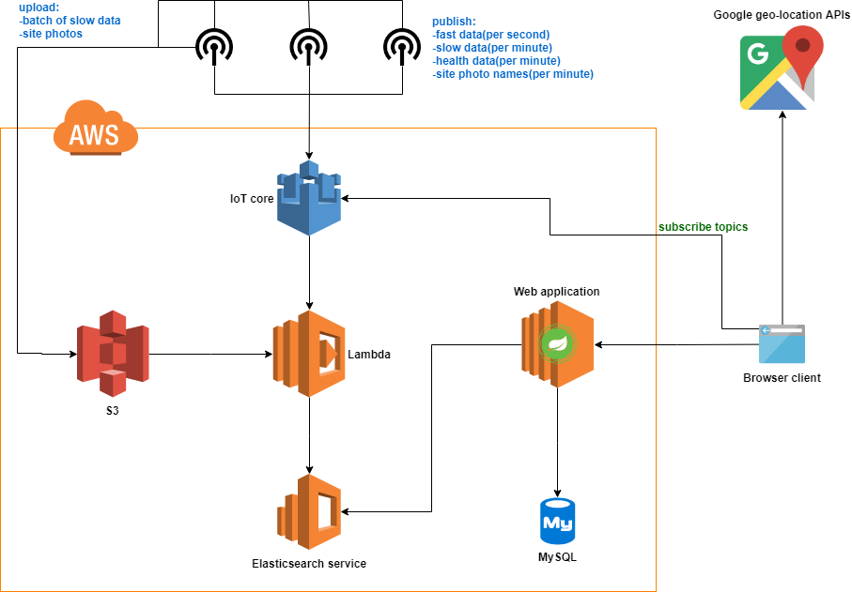
High Level Design

Slide 18
Development strategy
Increasement 0 | Project kick-off meeting Project planning Requirement gathering and modelling Prototyping focusing on: Station connecting and sending data to AWS IoT Core Transforming raw data(csv) to JSON by using NodeJS application and storing into NoSQL database
Increasement 1 | Prototyping focusing on: Transforming raw data(csv) to JSON by using Logstash Design modelling Features to be developed: User management Station management
Increasement 2 | Revising cloud architecture Design modelling Features to be developed: remaining all use cases SIT & UAT Release

Slide 19
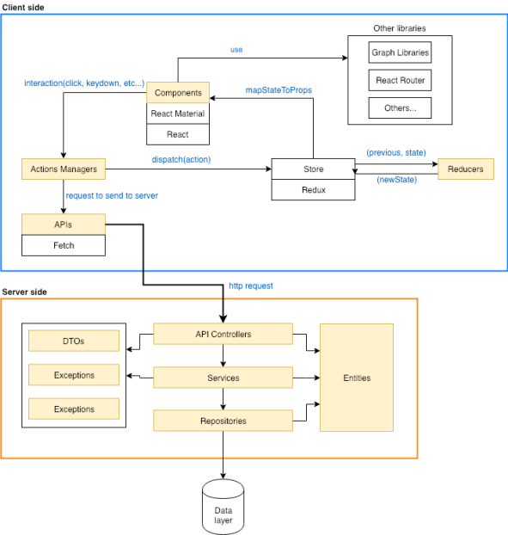
Web application layering

Slide 20
AM to DM Transition
Analysis Model | Design Model | Notes:
Screen | HTML nodes | Type script HTML codes which implemented in React component
Controller | Components | React components which are responsible for rendering HTML nodes and screen routings
 | Action managers | Type scripts file which are responsible for dispatching actions
 | APIs | Type scripts file which are responsible for sending HTTP requests to back-end APIs
 | API Controllers | JAVA Rest controller class which handle HTTP requests from client-side.
 | Services | Java classes which handle all back-end business logics.
Entity | State | State of the components which are stored in Redux Store at client-side.
 | Entities | Java classes which are used to map with data tables.

Slide 21
Programming languages & Frameworks
Client-side
Typescript, ReactJS, CSS3, HTML5
Server-side
JAVA, Spring Boot framework
NodeJS(AWS Lambda function)
Database
My SQL
Elasticsearch

Slide 22
Technical Issues
Transforming raw data(csv) to JSON:
needs user maintenance
Cannot emit real-time data to browsers due to data transforming latency
No official AWS IoT SDK for LabView

Slide 23
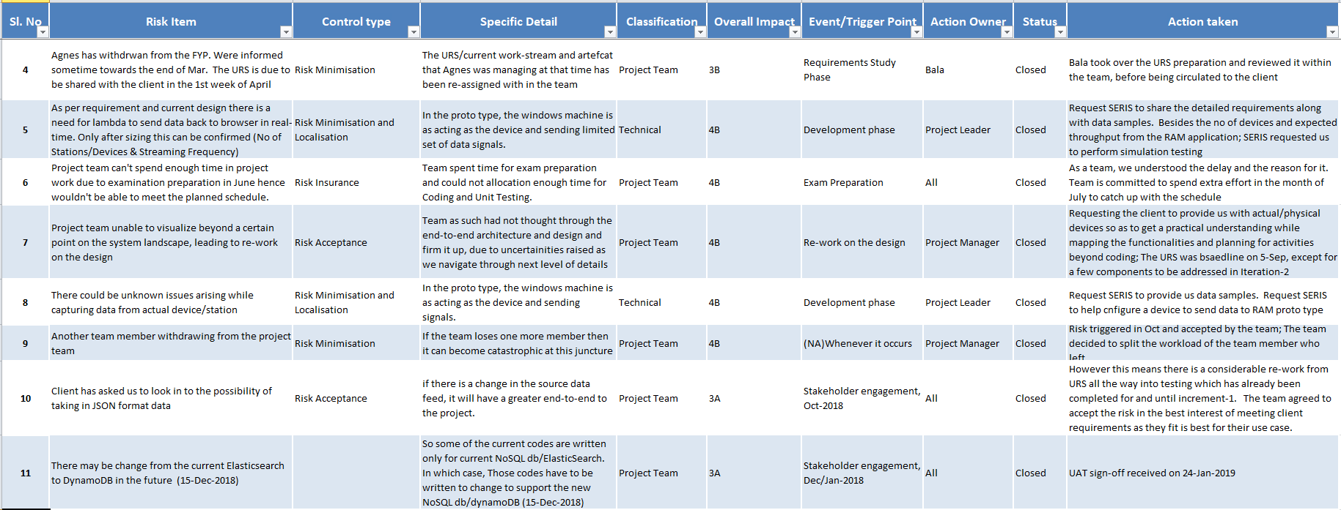
Risk Register

Slide 24
Project Status (Timeline)
2 - May
29-Aug
27-Jan
Phase / Timeline | Jan 2018 | Feb | Mar | Apr | May | Jun | Jul | Aug | Sep | Oct | Nov | Dec 2018 | Jan 2019
Increment 0 |  |  |  | 7
Increment 1
Increment 2
Initial Planning
Requirements Engineering
Requirements Analysis
Analysis and Design
Dev. (Env. Setup & Coding)
UT
SIT
SAD
Development
SIT
*UAT
#
@
*Training – Train the trainer # – Training @ – Handover
24

Slide 25
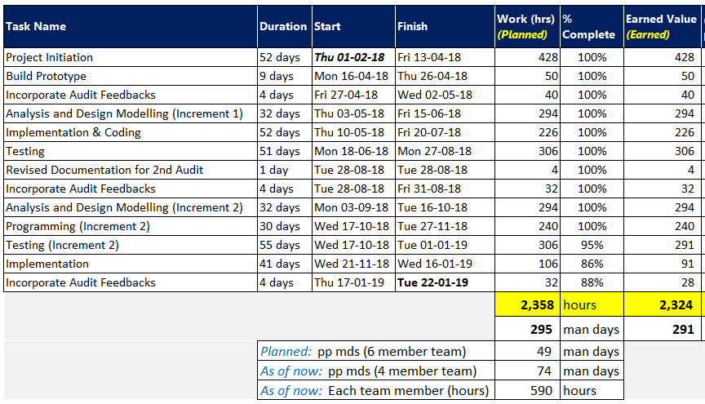
Project Status

Slide 26
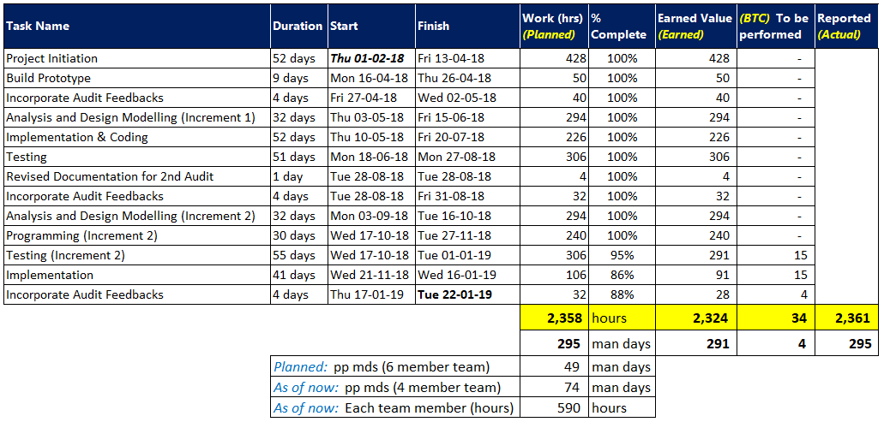
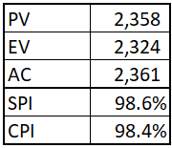
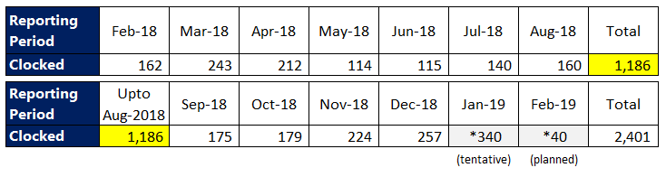
Project Status (Control, Tracking and Reporting)

Slide 27
Challenges
Architecture and Design
Couple of iterations until mid Oct
Finalized and agreed towards end Oct
Repeat certain components which were impacted
Resource Challenges
Agnes left during Incrment-0
Treza left during Increment-1
Team challenged with ‘do more with less’

Slide 28
Learnings
Architecture and Design
The journey (arch. & design iterations) helped us understand the ‘AWS and IoT’ topic better
Resource Challenges & Team work
The team was challenged with… ‘do more with less’
It gave us an opportunity to raise ourselves to the challenge
The team moved from ‘Norming’ stage to ‘Performing’

Slide 29
Next Steps… (not the end-of-the-road)
SERIS® will continue to invest on the solution delivered by us
The app we have built is going to be made available to their clients/customers
They also plan to hire a consultant to continue further to enhance the app
Moving to mobile platform(s) is made easier
We are using ReactJS for our web application
Only need to write FE – UI (Front-end User-Interface) for mobile platforms
Leveraging on the underlying React Native mobile framework

Slide 30


Q & A

Slide 31





Thank you
What’s Your Message?

Slide 32
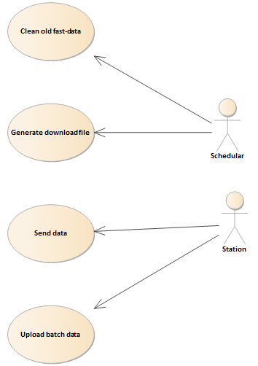
Use Case (cont..)

Slide 33
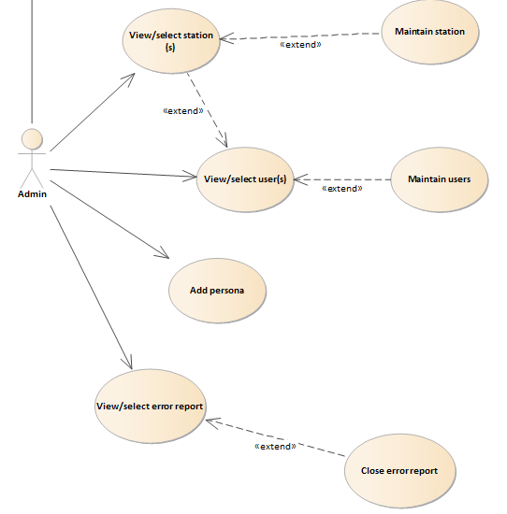
Use Case (cont..)

Slide 34
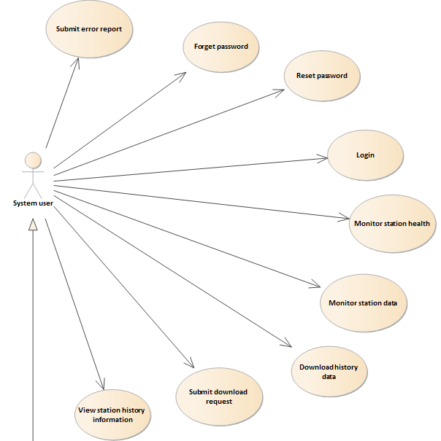
Use Case (cont..)

Slide 35
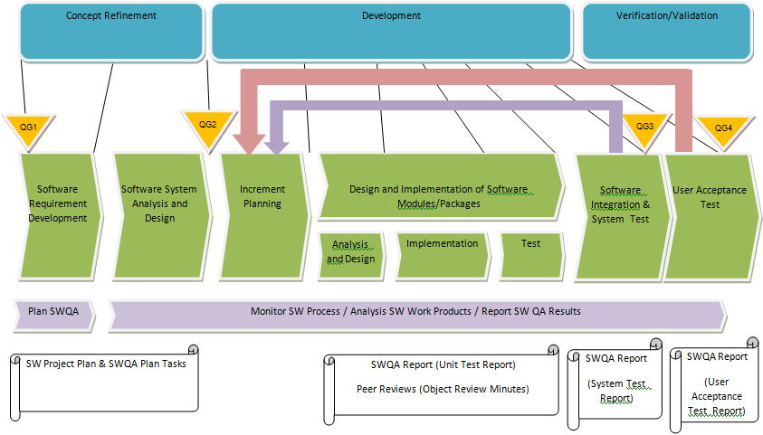
Quality Management Process

Slide 36
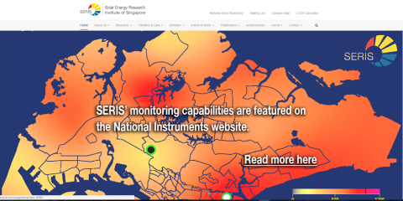
Project Sponsor
Singapore’s national institute for applied solar energy research
Is dedicated to research, development, testing and consulting on solar energy technologies and their integration into power systems and buildings
is globally active but focuses on technologies and services for tropical regions, in particular for Singapore and South-East Asia
is jointly sponsored by Singapore’s National Research Foundation (NRF) - via the Singapore Economic Development Board (EDB), and NUS
Campus located at NUS
www.seris.nus.edu.sg

Slide 37

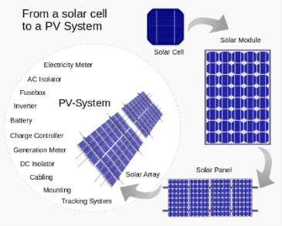

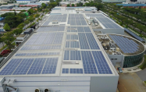


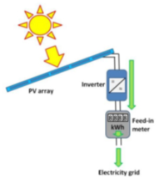
SERIS/NSR PV Systems
National Solar Repository of Singapore
PV System
Solar/Electrical Energy
Tuas
Sentosa
Changi

Slide 38
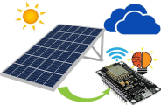




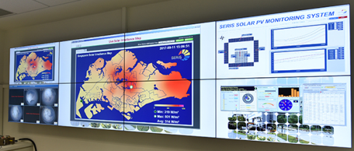


RAM Application Overview
PV System(s)
Central Data Engineering
RAM Web Portal
IoT Sensors
(Temp, Light, Current, Voltage.,)
Alerts
Browser Interface
SERIS Interface(Ext)
App Users

Slide 39
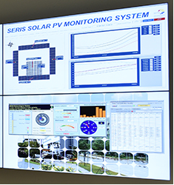
Project Scope – Web portal & SERIS Interface
Web portal
Browser Interface – Users access the application’s web-portal via a standard browser interface with an active internet connection
User login and Access control mapping – The system allows authorised user(s) to access the application. After authentication user will have access to main menu. Availability of menu functions depends on user’s level of access.
SERIS Interface
The interface between the application and SERIS central monitoring system. This interface enables communication and interaction between the proposed application and the SERIS Central Monitoring system

Slide 40

Project Team Structure
SERIS
Head of Solar System Technology Group (Dr.Zhao Lu)
ISS
Project Guide (Heng Boon Kui)
Project Manager
SERIS
Technical Specialist (Soe Pyae)
SE 25 – PT 07
Responsibility | Name
Project Manager | Kaung Myat Bo
Project Liaison | Kaung Myat Bo
System Architect | Treza Bawm Win
Quality Manager | Nay Lin Aung
Technical Leader | Gao Zhiyu
System Analyst | Vincent Agnes Evangelin
Change Manager | Balasubramanian Narasimhan
Developers/Software Engineers/Testers | Kaung Myat Bo, Nay Lin Aung, Treza Bawm Win, Gao Zhiyu, Vincent Agnes Evangelin, Balasubramanian Narasimhan
Quality Assurance Manager
System Architect
System Analyst
Lead Developer
Change Manager
Software Testers
Software Engineers

Slide 41
Deliverables and Increments
Planning & Feasibility Phase | Increment 1 Development Phase | Increment 2 Development Phase
Project Plan Quality Plan User Requirements Specification (URS) Use Case Model Survey (UCMS) Prototyping Study Report High-Level Design Spec | Requirements Model Report High-Level Design Spec(revised) Design Model Report System Test Documentation Acceptance Test Documentation Project Plan (revised) User Guide | Requirements Model Report (finalized) High-Level Design Spec(finalized) Design Model Report (finalized) System Test Doc (finalized) Acceptance Test Doc (finalized) User Guide (finalized) Final System End of Project Report

Slide 42
Technical Deliverables
File Category | File Reference | File Description
Work Files | SE25PT7SERIS/SERIS/TECH/TWORK/KMB SE25PT7SERIS/SERIS/TECH/TWORK/NAYLA SE25PT7SERIS/SERIS/TECH/TWORK/TREZA SE25PT7SERIS/SERIS/TECH/TWORK/GAOZY SE25PT7SERIS/SERIS/TECH/TWORK/BALA SE25PT7SERIS/SERIS/TECH/TEST/UT SE25PT7SERIS/SERIS/TECH/TEST/ST SE25PT7SERIS/SERIS/TECH/TEST/UAT | Kaung’s Workfile Nay’sWorkfile Treza’s Workfile Gao’sWorkfile Bala’sWorkfile Module/Unit Testing Workfile System Testing Workfile Acceptance Testing Workfile
Technical Specifications | SE25PT7SERIS/SERIS/SPEC/REQUIREMENT/URS SE25PT7SERIS/SERIS/SPEC/REQUIREMENT/UIS SE25PT7SERIS/SERIS/TECH/DESIGN/HLD SE25PT7SERIS/SERIS/TECH/USER/API SE25PT7SERIS/SERIS/TECH/DEPLOY/DPC | User Requirement Spec User Interface Spec High Level Design Specification Programmer’s Manual Deployment Document
User Documents | SE25PT7SERIS/SERIS/TECH/USER/UG | User’s Manual
Software Configuration Management | SE25PT7SERIS/SERIS/TECH/LOGS/TC.1 SE25PT7SERIS/SERIS/TECH/LOGS/TC.2 SE25PT7SERIS/SERIS/TECH LOGS/TC.3 SE25PT7SERIS/SERIS/TECH/LOGS/TC.4 | Observation Reports/Error Log Change Record in Change Log Testing & Verification Log Configuration Log of all versions

Slide 43
Management Deliverables
File Category | File Reference | File Description
Project Communication | SE25PT7SERIS/SERIS/MGMT/MEETING/EC SE25PT7SERIS/SERIS/MGMT/MEETING/ /IC SE25PT7SERIS/SERIS/MGMT/MEETING/AUM SE25PT7SERIS/SERIS/MGMT/PLAN/WIF | External Correspondence Internal Correspondence Audit Minutes Work Instruction Forms
Plans | SE25PT7SERIS/SERIS/MGMT/PLAN/PP SE25PT7SERIS/SERIS/MGMT/QUALITY/MTP SE25PT7SERIS/SERIS/MGMT/QUALITY/UTP SE25PT7SERIS/SERIS/MGMT/QUALITY/STP SE25PT7SERIS/SERIS/MGMT/QUALITY/ATP | Project Plan Master Test Plan Module/Unit Test Plan System Test Plan Acceptance Test Plan
Quality | SE25PT7SERIS/SERIS//MGMT/QUALITY/QP SE25PT7SERIS/SERIS/MGMT/QUALITY/PFP SE25PT7SERIS/SERIS/MGMT/QUALITY/CP | Quality Assurance Plan Project Procedures Configuration Procedures
Reporting and Progress Control | SE25PT7SERIS/SERIS/MGMT/PLAN/TR SE25PT7SERIS/SERIS/MGMT/PLAN/PR | Time Reports Progress Reports

